Slide 1
Advancing Healthcare using Social Media Analysis
Advisor - Motahareh Pourbehzadi
Team Members-
Eric Massicot
Faith Oluwayemi
Himadeep Movva
Kumar Amrit Vankadara
Team Salmon

Slide 2
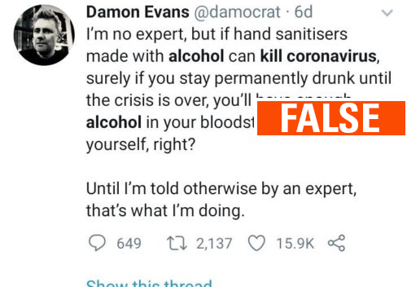
Problem Statement
In this digital age, handling widespread misinformation through either impersonation or fake news has been challenging in every walk of life. More so, especially in the case of covid-19 pandemic. We are developing a system that addresses fake tweets related to covid-19, enabling the users to take a call regarding truth value of a tweet.

Slide 3
Literature
Title of Paper | Journal
Going viral: How a single tweet spawned a COVID-19 conspiracy theory on Twitter | Big Data & Society
COVID-19 ON SOCIAL MEDIA: ANALYZING MISINFORMATION IN TWITTER CONVERSATIONS | Arxiv (open-access repository)
Different Types of COVID-19 Misinformation have Different Emotional Valence on Twitter | Big Data & Society
COVID-19 Twitter dataset with latent topics, sentiments and emotions attributes | Arxiv (open-access repository)
Artificial Intelligence–Enabled Analysis of Public Attitudes on Facebook and Twitter Toward COVID-19 Vaccines | JOURNAL OF MEDICAL INTERNET RESEARCH

Slide 4
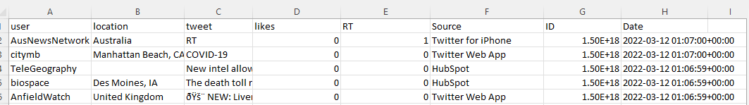
Dataset

Slide 5
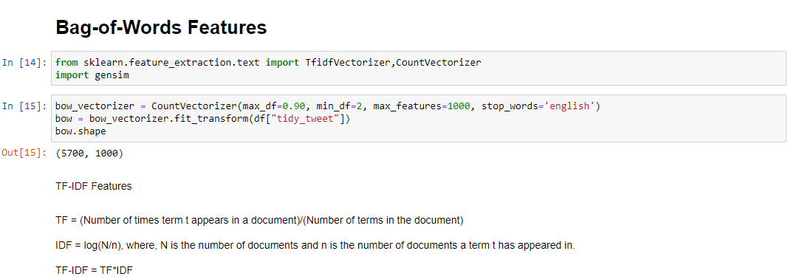
Python Code

Slide 6
Milestones
Retrieving tweets from twitter
Data preparation
Bag of word
TF-IDF
Story generation and visualization from tweets
Word embeddings
Model building

Slide 7
Thank you

